Slide 1

Reliable, Efficient and Light Distance Computation on High-Dimensional Vectors
Jianyang Gao
^{Jianyang.gao@ntu.edu.sg}
Nanyang Technological University
26/09/2024@ByteDance

Slide 2
Outline
ANN with Efficient and Reliable Distance Comparisons (SIGMOD’23)
ANN with Efficient and Reliable Distance Estimation (SIGMOD’24)
Practical and Asymptotically Optimal Quantization (Preprint)

Slide 3
ANN Algorithms
Generate candidates.
Find the NN from candidates.
Query Vector
ANN
Database
Candidates
ANN algorithms heuristically generate a few candidates and find ANN from them.
Existing Methods
Partition-based, e.g., IVF[1]
Graph-based, e.g., HNSW[2]
[1] Jegou, Herve, Matthijs Douze, and Cordelia Schmid. "Product quantization for nearest neighbor search." IEEE transactions on pattern analysis and machine intelligence 33.1 (2010): 117-128.
[2] Yu A. Malkov and D. A. Yashunin. 2020. Efficient and Robust Approximate Nearest Neighbor Search Using Hierarchical Navigable Small World Graphs. IEEE Trans. Pattern Anal. Mach. Intell. 42, 4 (April 2020), 824–836.

Slide 4






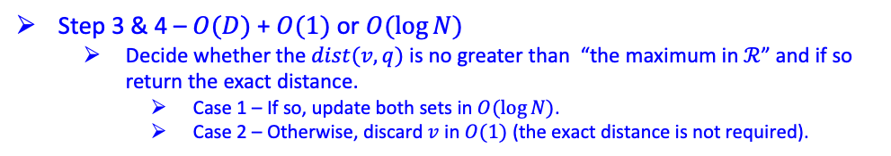




Graph-based Algorithms
Initialize both sets with a starting point $s$.
query vector
Search in iterations:
data vector
$$u$$
$$v$$
Step 1 – $O(\log{N})$
Fetch the object $u$ which has the smallest distance in $𝒮$ and pop it out.
Step 2 – $O(1)$ for each unvisited neighbor
Visit an unvisited neighbor $v$ of $u$.
Step 3 – $O(D)$
Compute $v$’s exact distance.
Step 4 – $O(1)$ or $O(\log{N})$
Compare the distance with “the maximum in $ℛ$”.
Case 1 – If its distance is no greater, then update both sets with $v$ in $O(\log{N})$.
Case 2 – Otherwise, discard $v$ in $O(1)$.
Query Phase
Index Phase
$$dist(v, q)$$
(*) Step 3 dominates the time cost.
Fixed Size $N_{ef}$ (Larger than $K$)
Step 3 & 4 – $O(D)$ + $O(1)$ or $O(\log{N})$
Decide whether the $dist(v,q)$ is no greater than “the maximum in $ℛ$” and if so return the exact distance.
Case 1 – If so, update both sets in $O(\log{N})$.
Case 2 – Otherwise, discard $v$ in $O(1)$ (the exact distance is not required).
Result Set: $ℛ$
compare
(***) Most cases would be Case 2.
(max-heap ordered by the distance)
Search Set: $𝒮$
$$u$$
(min-heap ordered by the distance)
(**) Case 2 does not require the exact distance.
Terminate when “the maximum in $ℛ$” < “the minimum in $𝒮$”.
Similar analysis can be made on nearly all other types of ANN algorithms
* By “distance”, we refer to the distance from the query.

Slide 5
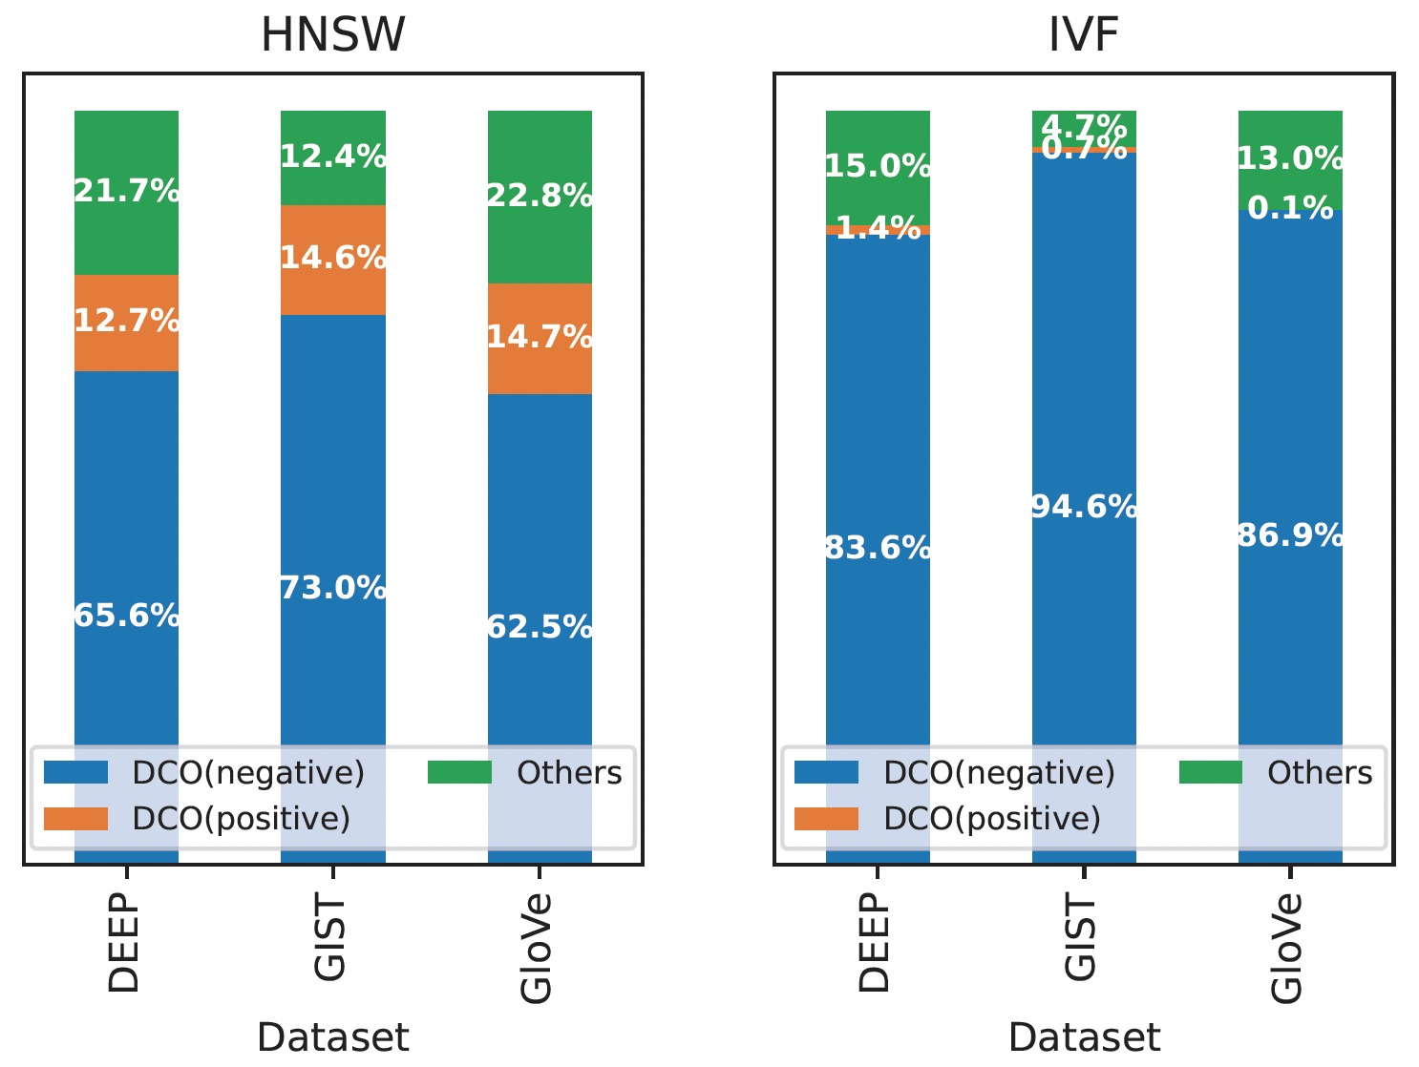
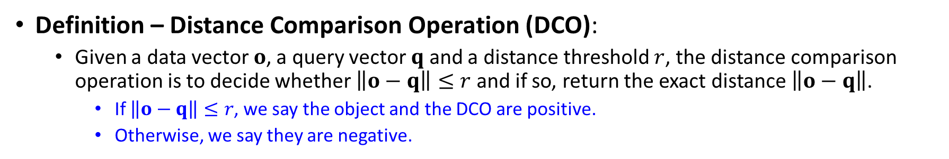
Distance Comparison Operation
Definition – Distance Comparison Operation (DCO):
Given a data vector $o$, a query vector $q$ and a distance threshold $r$, the distance comparison operation is to decide whether $\left\|o−q\right\|≤r$ and if so, return the exact distance $\left\|o−q\right\|$.
If $\left\|o−q\right\|≤r$, we say the object and the DCO are positive.
Otherwise, we say they are negative.
Observations
(*) DCOs dominate the time cost of ANN algorithms.
(**) Negative objects will be discarded and do not require the exact distances.
(***) Most DCOs/objects are negative.
We target to conduct DCOs efficiently and reliably.

Slide 6
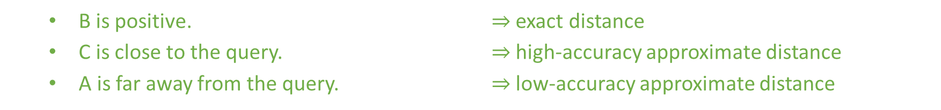
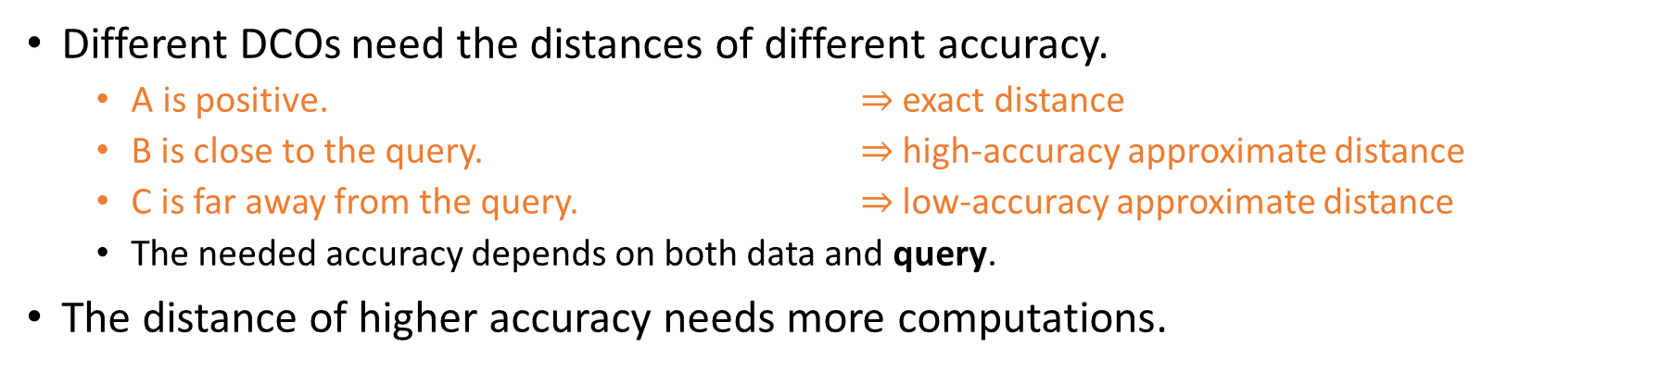
Flexibility and Adaptivity
Different DCOs need the distances of different accuracy.
A is positive. $⇒$ exact distance
B is close to the query. $⇒$ high-accuracy approximate distance
C is far away from the query. $⇒$ low-accuracy approximate distance
The needed accuracy depends on both data and query.
The distance of higher accuracy needs more computations.
B is positive. $⇒$ exact distance
C is close to the query. $⇒$ high-accuracy approximate distance
A is far away from the query. $⇒$ low-accuracy approximate distance
C
A
Flexibility: How to make it possible that different DCOs can choose different accuracy of their distances during the query phase?
Adaptivity: How to decide the minimum needed accuracy to ensure the reliability of DCOs?
query
B
query

Slide 7




Flexibility
Index Phase
Query Phase
?
projected query vector
generate
subsample
$$×$$
$$=$$
Random Projection
Random Orthogonal Transformation
Random Orthogonal Projection
data vector
projected data vector
approximate distance
(fixed dimensionality)
(fixed accuracy)
$$×$$
$$=$$
subsample
transformed query vector
Dimension Sampling
on Transformed Vectors
Random Orthogonal Transformation
data vector
transformed data vector
sampled vector
approximate distance
(flexible dimensionality)
(flexible accuracy)
Question (Flexibility):
How to make it possible that different DCOs can choose different accuracy of their distances during the query phase?
Solution:
To randomly transform the vectors and sample different number of dimensions as needed during the query phase.

Slide 8


Adaptivity
Our method samples the dimensions in iterations until it is enough.
In each iteration,
incrementally samples a few dimensions
checks whether it can “confidently claim” a negative result
When all the $D$ dimensions have been sampled,
It will get the exact distance because we adopt random orthogonal transformation which does not distort the distances.
No? Continue sampling.
?
Yes? Return a negative result.
$ε_{0}$ is a parameter which controls the failure probability and time complexity.
$$dis′>\left(1+\frac{ε_{0}}{\sqrt{d}}\right)⋅r⇒\left\|o − q\right\|>r$$
?
$$dis′≫r⇒\left\|o − q\right\|>r$$
a factor derived from the concentration inequality of random projection & hypothesis testing
Question (Adaptivity):
How to decide the minimum number of dimensions to ensure the reliability of DCOs?
Solution:
To incrementally sample on the trans-formed vectors and terminate when it can confidently claim a negative result.

Slide 9
ADSampling
Flexibility:
To randomly transform the vectors and sample different number of dimensions as needed during the query phase.
+
ADSampling
(Adaptive Dimension Sampling)
Adaptivity:
To incrementally sample on the transformed vectors and terminate when it can confidently claim a negative result.

Slide 10

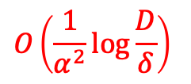





Theoretical Analysis
 | Positive (a few) | Negative (many)
Failure Probability
Time Complexity
$$≤δ$$
0
$$O(D)$$
$$O\left(\frac{1}{α^{2}}\log{\frac{D}{δ}}\right)$$
The distance gap $α$affect the time complexity.
larger $α$ $⇒$ more room for approximation
$$o$$
$$q$$
$$r$$
distance gap $α=\frac{\left\|o−q\right\|−r}{r}$

Slide 11
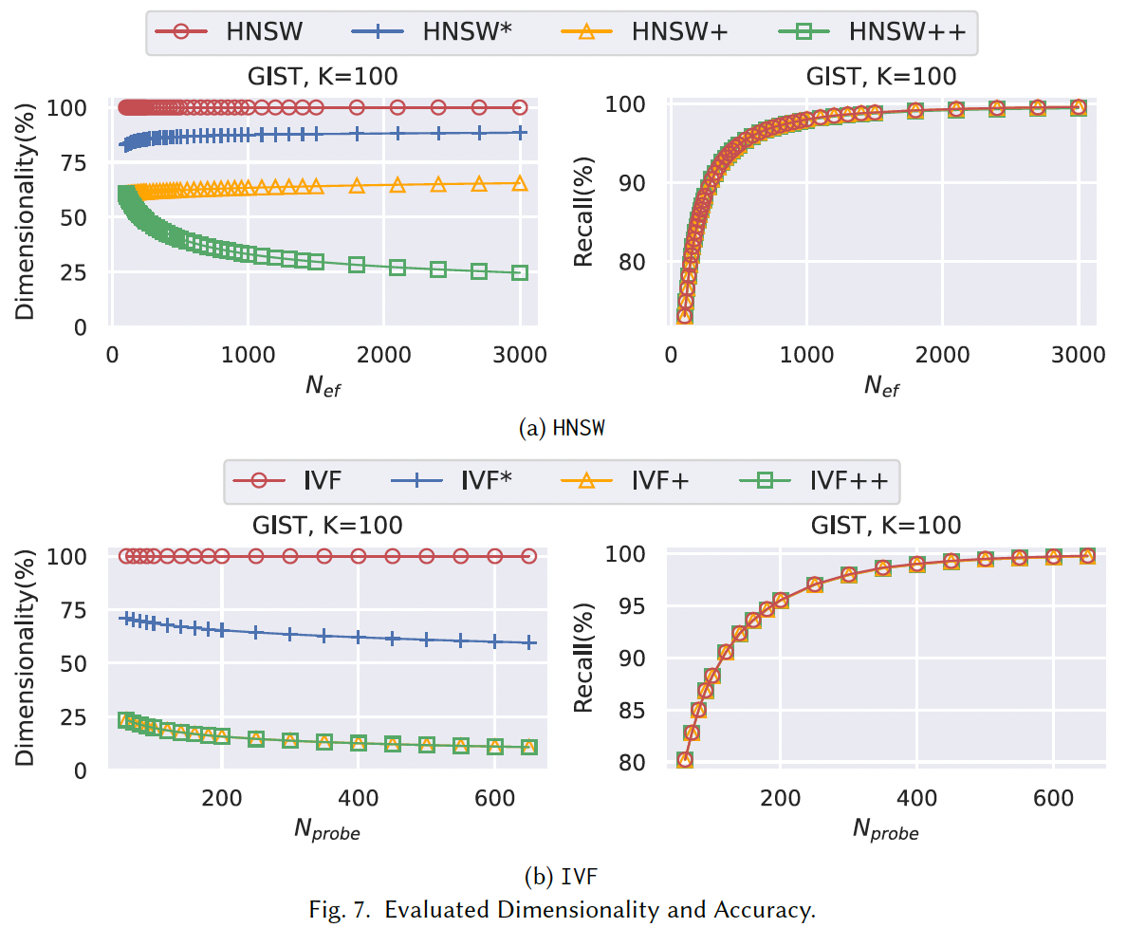
Dimensionality & Recall
ADSampling

Slide 12
Summary
Problem: we identify the distance comparison operation for approximate nearest neighbor search.
Algorithm: we propose a randomized algorithm ADSampling.
It can adaptively sample a certain number of dimensions based on the needs.
Theoretical Analysis: we prove that ADSampling is reliable and has logarithmic time complexity in most cases.

Slide 13
Outline
ANN with Efficient and Reliable Distance Comparisons (SIGMOD’23)
ANN with Efficient and Reliable Distance Estimation (SIGMOD’24)
Practical and Asymptotically Optimal Quantization (Preprint)

Slide 14
Estimating Distances with Quantization
Product Quantization (PQ) and its variants [3-5]
With Fast Scan[5], they can efficiently and accurately estimate distances for many datasets.
They are widely adopted in libraries from industry (e.g., Meta, Google, Yahoo Japan).
Despite their empirical success
They have no guarantee on the accuracy of estimated distances (Theoretical).
can only provide biased distance estimation
They are observed to fail disastrously on some real-world datasets (Empirical).
cannot achieve >60% recall on the MSong dataset (with re-ranking applied)
This further motivates us to design a quantization method which
(1) has a rigorous theoretical error bound and (2) supports efficient distance estimation.
[3] Jegou, Herve, Matthijs Douze, and Cordelia Schmid. "Product quantization for nearest neighbor search." IEEE transactions on pattern analysis and machine intelligence 33.1 (2010): 117-128.
[4] Ge, Tiezheng, et al. "Optimized product quantization for approximate nearest neighbor search." Proceedings of the IEEE conference on computer vision and pattern recognition. 2013.
[5] Fabien André, Anne-Marie Kermarrec, and Nicolas Le Scouarnec. 2017. Accelerated Nearest Neighbor Search with Quick ADC. In Proceedings of the 2017 ACM on International Conference on Multimedia Retrieval (ICMR '17). Association for Computing Machinery, New York, NY, USA, 159–166. https://doi.org/10.1145/3078971.3078992

Slide 15
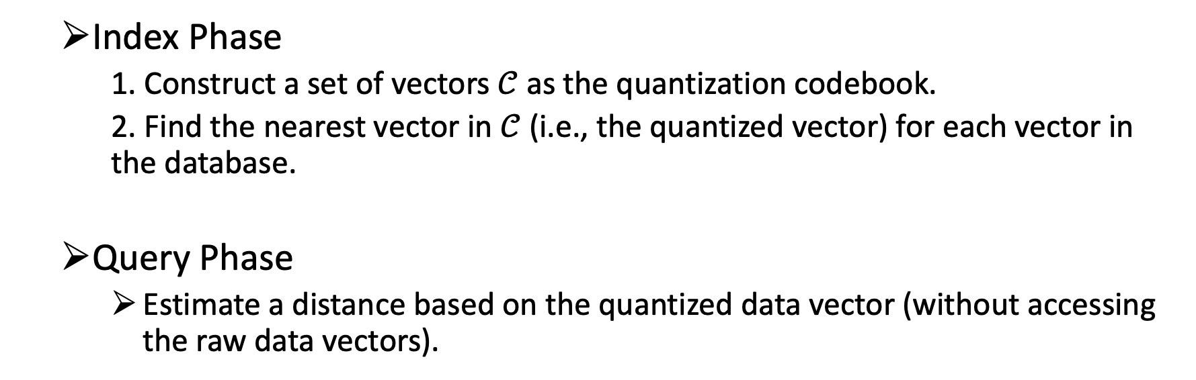
Overview of Quantization
Index Phase
1. Construct a set of vectors $𝒞$as the quantization codebook.
2. Find the nearest vector in $𝒞$ (i.e., the quantized vector) for each vector in the database.
Query Phase
Estimate a distance based on the quantized data vector (without accessing the raw data vectors).
To provide a rigorous theoretical error bound, the whole algorithm must be carefully and integratedly designed.

Slide 16



Pre-Processing: Normalization
Directly constructing a codebook for the raw data vectors is challenging.
The raw vectors may appear anywhere in the unbounded Euclidean space.
Solution:
Let $o_{r}$ and $q_{r}$ be the raw data and query vector.
Let $o$ and $q$ be their corresponding normalized vectors with respect to a vector $c$.
$$o=\frac{o_{r}−c}{\left\|o_{r}−c\right\|}$$
$$q=\frac{q_{r}−c}{\left\|q_{r}−c\right\|}$$
$${\left\|o_{r}−q_{r}\right\|}^{2}={\left\|o_{r}−c\right\|}^{2}+{\left\|q_{r}−c\right\|}^{2}−2 \left\|o_{r}−c\right\| \left\|q_{r}−c\right\| \left\langle o,q\right\rangle$$
The Original Target
Pre-computed
Shared by all data vectors
Pre-computed
Shared by all data vectors
The New Target

Slide 17
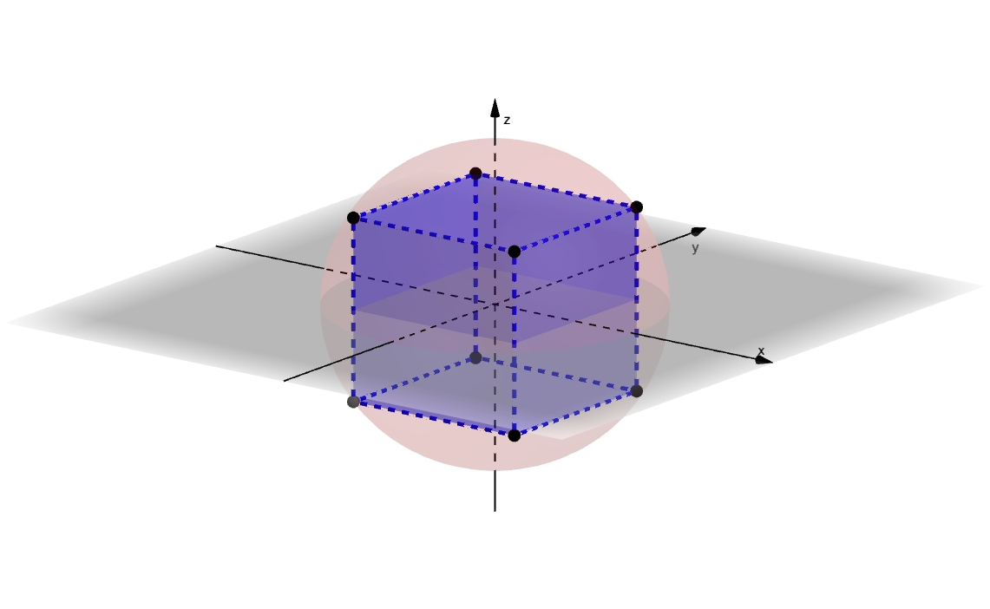
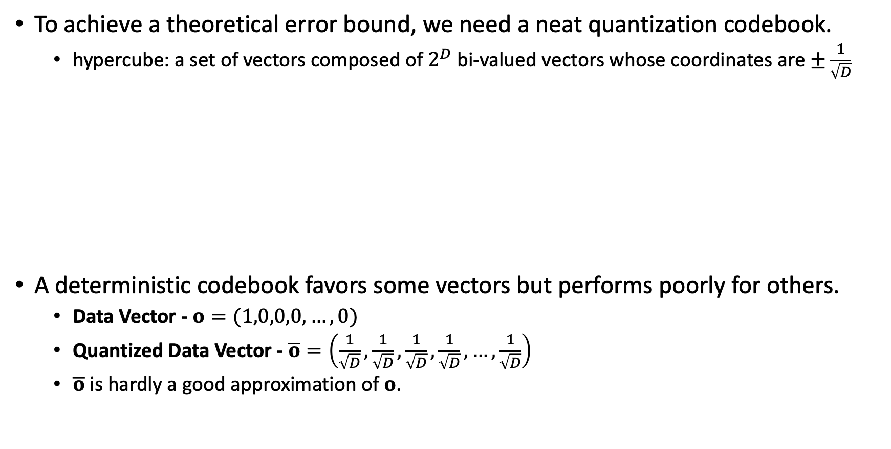

Index Phase: Construct a Codebook
To achieve a theoretical error bound, we need a neat quantization codebook.
hypercube: a set of vectors composed of $2^{D}$ bi-valued vectors whose coordinates are $±\frac{1}{\sqrt{D}}$
A deterministic codebook favors some vectors but performs poorly for others.
Data Vector - $o=(1,0,0,0,…,0)$
Quantized Data Vector - $\overline{o}=\left(\frac{1}{\sqrt{D}},\frac{1}{\sqrt{D}},\frac{1}{\sqrt{D}},\frac{1}{\sqrt{D}},…,\frac{1}{\sqrt{D}}\right)$
$\overline{o}$ is hardly a good approximation of $o$.
$$𝒞={\left\{−\frac{1}{\sqrt{D}},+\frac{1}{\sqrt{D}}\right\}}^{D}$$

Slide 18
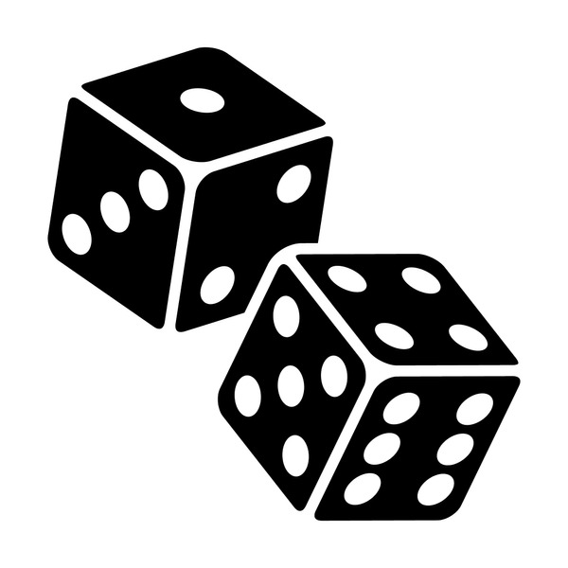


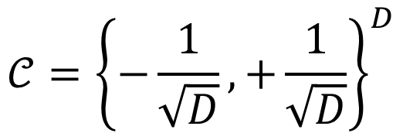
Index Phase: Randomly Rotate the Codebook
Rotate the codebook by multiplying its vectors with a random orthogonal matrix
$$𝒞={\left\{−\frac{1}{\sqrt{D}},+\frac{1}{\sqrt{D}}\right\}}^{D}$$
$$𝒞_{rand}=\left\{Pc|c∈𝒞\right\}$$
For each vector, we find its quantized vector from the randomized codebook.
A quantized vector is represented and stored as a 𝐷-bit string, where 0 and 1 indicate the two distinct values.
* $P$ is a Johnson-Lindenstrauss Transformation.

Slide 19

Index Phase: Find the Nearest Vector
How to find the nearest vector for a unit vector $o$ in $𝒞_{rand}$?
Reversely rotate the data vector, i.e., to obtain $P^{−1}o$.
Find its nearest vector in the codebook $\overline{x}∈𝒞$.
This is easy because $𝒞={\left\{−\frac{1}{\sqrt{D}},+\frac{1}{\sqrt{D}}\right\}}^{D}$.
The nearest vector can be found by viewing the signs of $P^{−1}o$.
$\overline{o}=P\overline{x}$ is the quantized vector.

Slide 20
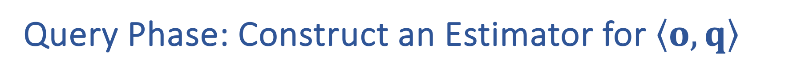
Query Phase: Construct an Estimator for $\left\langle o,q\right\rangle$
PQ and its variants simply treat the quantized data vector as the data vector.
To achieve a theoretical guarantee, we analyze the geometric relationship among these vectors.

Slide 21
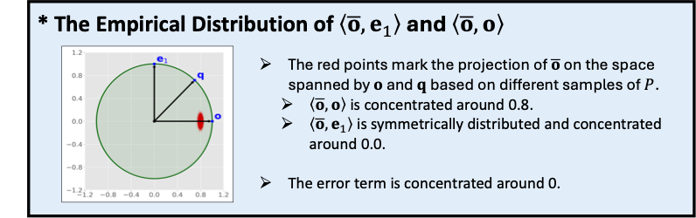

The Distribution of $\left\langle \overline{o},o\right\rangle$ and $\left\langle \overline{o},e_{1}\right\rangle$

Slide 22
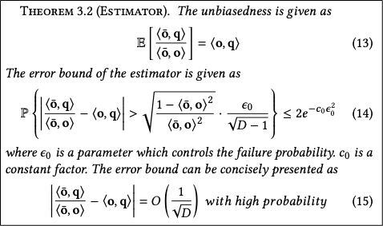
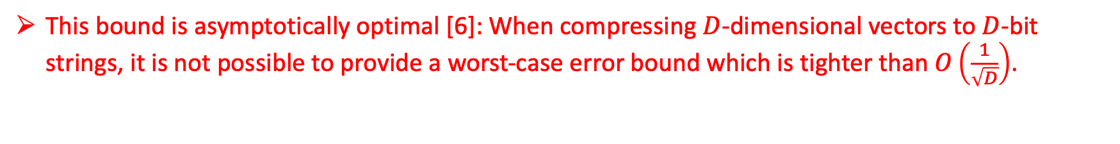
Query Phase: the Error Bound
unbiasedness
an error bound
This bound is asymptotically optimal [6]: When compressing $D$-dimensional vectors to $D$-bit strings, it is not possible to provide a worst-case error bound which is tighter than $O\left(\frac{1}{\sqrt{D}}\right)$.
[6] Noga Alon and Bo’az Klartag. 2017. Optimal Compression of Approximate Inner Products and Dimension Reduction. In 2017 IEEE 58th Annual Symp. on Foundations of Computer Science (FOCS). 639–650.

Slide 23
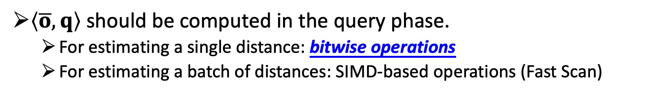
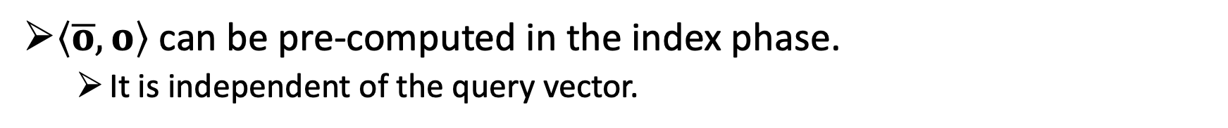

Query Phase: Computing $\left\langle \overline{o},q\right\rangle /\left\langle \overline{o},o\right\rangle$
$\left\langle \overline{o},o\right\rangle$ can be pre-computed in the index phase.
It is independent of the query vector.
$\left\langle \overline{o},q\right\rangle$ should be computed in the query phase.
For estimating a single distance: bitwise operations
For estimating a batch of distances: SIMD-based operations (Fast Scan)

Slide 24
How to compute $\left\langle \overline{o},q\right\rangle$?
Let $\overline{x}=P^{−1}\overline{o}$. Note that $\overline{x}$ is a bi-valued vector whose coordinates are $±\frac{1}{\sqrt{D}}$.
We express $\overline{x}$ with its binary representation: $\overline{x}=\frac{2}{\sqrt{D}}\left({\overline{x}}_{b}−\frac{1_{D}}{2}\right), {\overline{x}}_{b}={\left\{0, 1\right\}}^{D}$.
Let $q^{′}=P^{−1}q$.
$$\left\langle \overline{o},q\right\rangle =\left\langle P\overline{x},q\right\rangle =\left\langle \overline{x},P^{−1}q\right\rangle =\left\langle \frac{2}{\sqrt{D}}\left({\overline{x}}_{b}−\frac{1_{D}}{2}\right),q′ \right\rangle$$
$$=\frac{2}{\sqrt{D}}\left\langle {\overline{x}}_{b},q′\right\rangle −\frac{1}{\sqrt{D}}\sum_{i=1}^{D}{q^{′}[i]}$$
binary $×$ float

Slide 25

How to compute $\left\langle {\overline{x}}_{b},q′\right\rangle$?
We target to estimate $\left\langle o,q\right\rangle$.
It suffices if the error of the computation $≪$ the error of the estimator.
$$\overline{q}=Δ⋅{\overline{q}}_{u}+v_{l}, {\overline{q}}_{u}\left[i\right]∈\{0,1,2,3,…,2^{B_{q}}−1\}$$
We apply a randomized version of $B_{q}$-bit scalar quantization to $q′$.
We approximately compute $\left\langle {\overline{x}}_{b},q′\right\rangle ≈\left\langle {\overline{x}}_{b},\overline{q}\right\rangle =Δ⋅\left\langle {\overline{x}}_{b},{\overline{q}}_{u}\right\rangle +v_{l}⋅∑{\overline{x}}_{b}$.
binary $×$ $B_{q}$-bit unsigned integer
*In practice, $B_{q}=4$

Slide 26
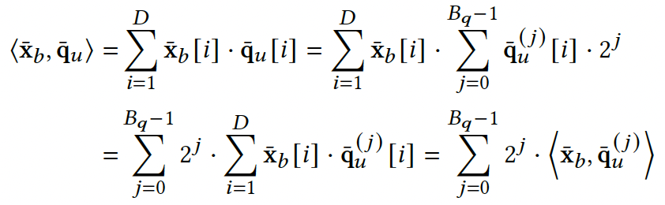
How to compute $\left\langle {\overline{x}}_{b},{\overline{q}}_{u}\right\rangle$?
We decompose the 4-bit unsigned integer vectors into 4 binary vectors.
The inner product can be realized with bitwise-and and popcount.

Slide 27
Experimental Setup
Baseline (PQ, OPQ and LSQ, all from Faiss 1.7.4)
For estimating a single distance: looking up tables in RAM
For estimating a batch of distances: Fast Scan (with AVX2)
Ours (RaBitQ)
For estimating a single distance: bitwise operations
For estimating a batch of distances: Fast Scan (with AVX2)

Slide 28
Results for Time-Accuracy Trade-off (Distance)
For estimating a single distance (8-bit PQ)
RaBitQ is ~3x faster under the same accuracy.
RaBitQ: bitwise operations
The baselines: looking up tables in RAM
For estimating a batch of distances (4-bit PQ)
By default, RaBitQ uses ~D bits of quantization codes and the baselines use 2D bits of quantization codes.
RaBitQ produces consistently better accuracy than PQ and OPQ.
Stability
RaBitQ produces stable performance even on the datasets where the baselines fail disastrously.

Slide 29
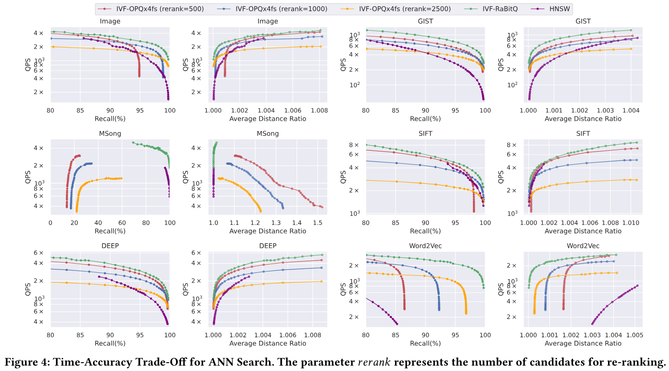
Results for Time-Accuracy Trade-off (ANN)

Slide 30
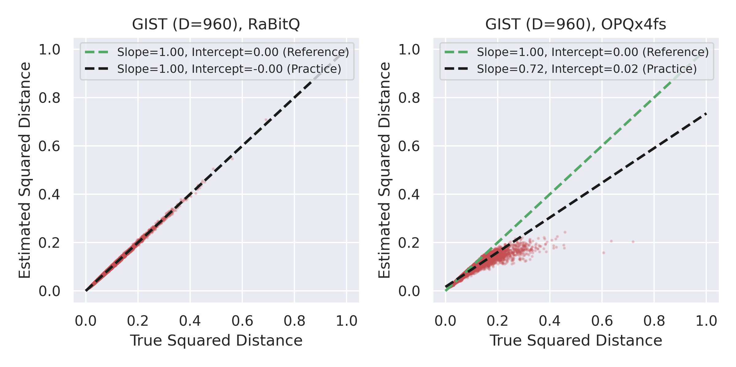
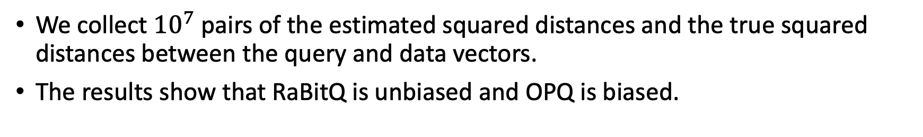
Results for Unbiasedness
We collect ${10}^{7}$ pairs of the estimated squared distances and the true squared distances between the query and data vectors.
The results show that RaBitQ is unbiased and OPQ is biased.

Slide 31
Summary
 | RaBitQ (new) | PQ and its variants
Codebook | Randomly transformed bi-valued vectors. | Cartesian product of sub-codebooks.
Quantization Code | A length-D bit string. | A sequence of 4-bit/8-bit unsigned integers.
Distance Estimator | Unbiased and provides an asymptotically optimal error bound. | Biased and provide no error bound.
Implementation (single) | Bitwise operations.  | Looking up tables in RAM. 
Implementation (batch) | Fast SIMD-based operations.  | Fast SIMD-based operations. 

Slide 32
Outline
ANN with Efficient and Reliable Distance Comparisons (SIGMOD’23)
ANN with Efficient and Reliable Distance Estimation (SIGMOD’24)
Practical and Asymptotically Optimal Quantization (Preprint)

Slide 33
Limitation of RaBitQ
RaBitQ only supports to compress vectors with a large compression rate (32x).
However, aggressive compression with 32x compression rate only produces poor recall without re-ranking (e.g., cannot stably exceed 80%).
To produce reasonable recall without re-ranking, it is necessary to compress the vectors moderately.
If re-ranking is applied, an algorithm must store the raw vectors in RAM or access them on disks. The former fails to reduce memory consumption. The latter non-trivially decreases the efficiency.
How to support moderate compression rates and keep promising performance?

Slide 34
Naïve Extension: Padding
The error decays slowly with respect to the used number of bits.
Example: $32D$ bits only guarantee the error of $O\left(\frac{1}{\sqrt{32D}}\right)$.

Slide 35
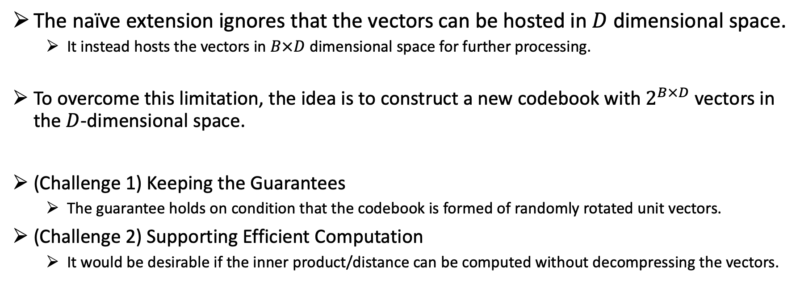
Advanced Extension: New Codebook
The naïve extension ignores that the vectors can be hosted in $D$ dimensional space.
It instead hosts the vectors in $B×D$ dimensional space for further processing.
To overcome this limitation, the idea is to construct a new codebook with $2^{B×D}$ vectors in the $D$-dimensional space.
(Challenge 1) Keeping the Guarantees
The guarantee holds on condition that the codebook is formed of randomly rotated unit vectors.
(Challenge 2) Supporting Efficient Computation
It would be desirable if the inner product/distance can be computed without decompressing the vectors.

Slide 36
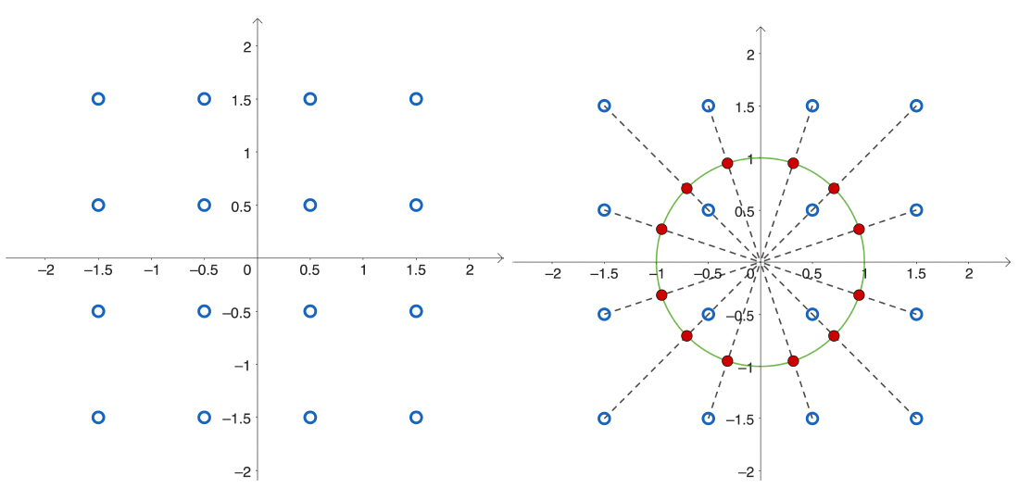
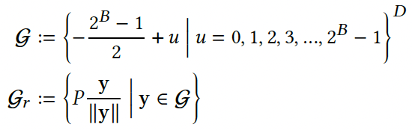

New Codebook: Normalizing Uniform Grids
Formal Expression
Example
(Challenge 1) Keeping the Guarantees
The guarantee holds on condition that the codebook is formed of randomly rotated unit vectors.
(Challenge 2) Supporting Efficient Computation
It would be desirable if the inner product/distance can be computed without decompressing the vectors.

Slide 37
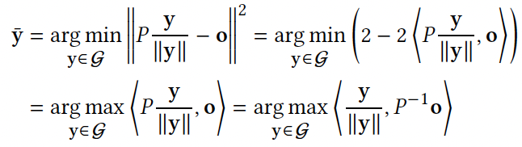
Challenges in Computing the Quantization Codes
RaBitQ can find the nearest vector in the codebook by reversely rotating the data vectors.
In the extended RaBitQ, it is not as easy as the original RaBitQ.
It somewhat entails to enumerate the vectors in the codebook to find the quantized data vector.
The new codebook contains $2^{B×D}$ vectors, causing the enumeration to be exhaustive.

Slide 38
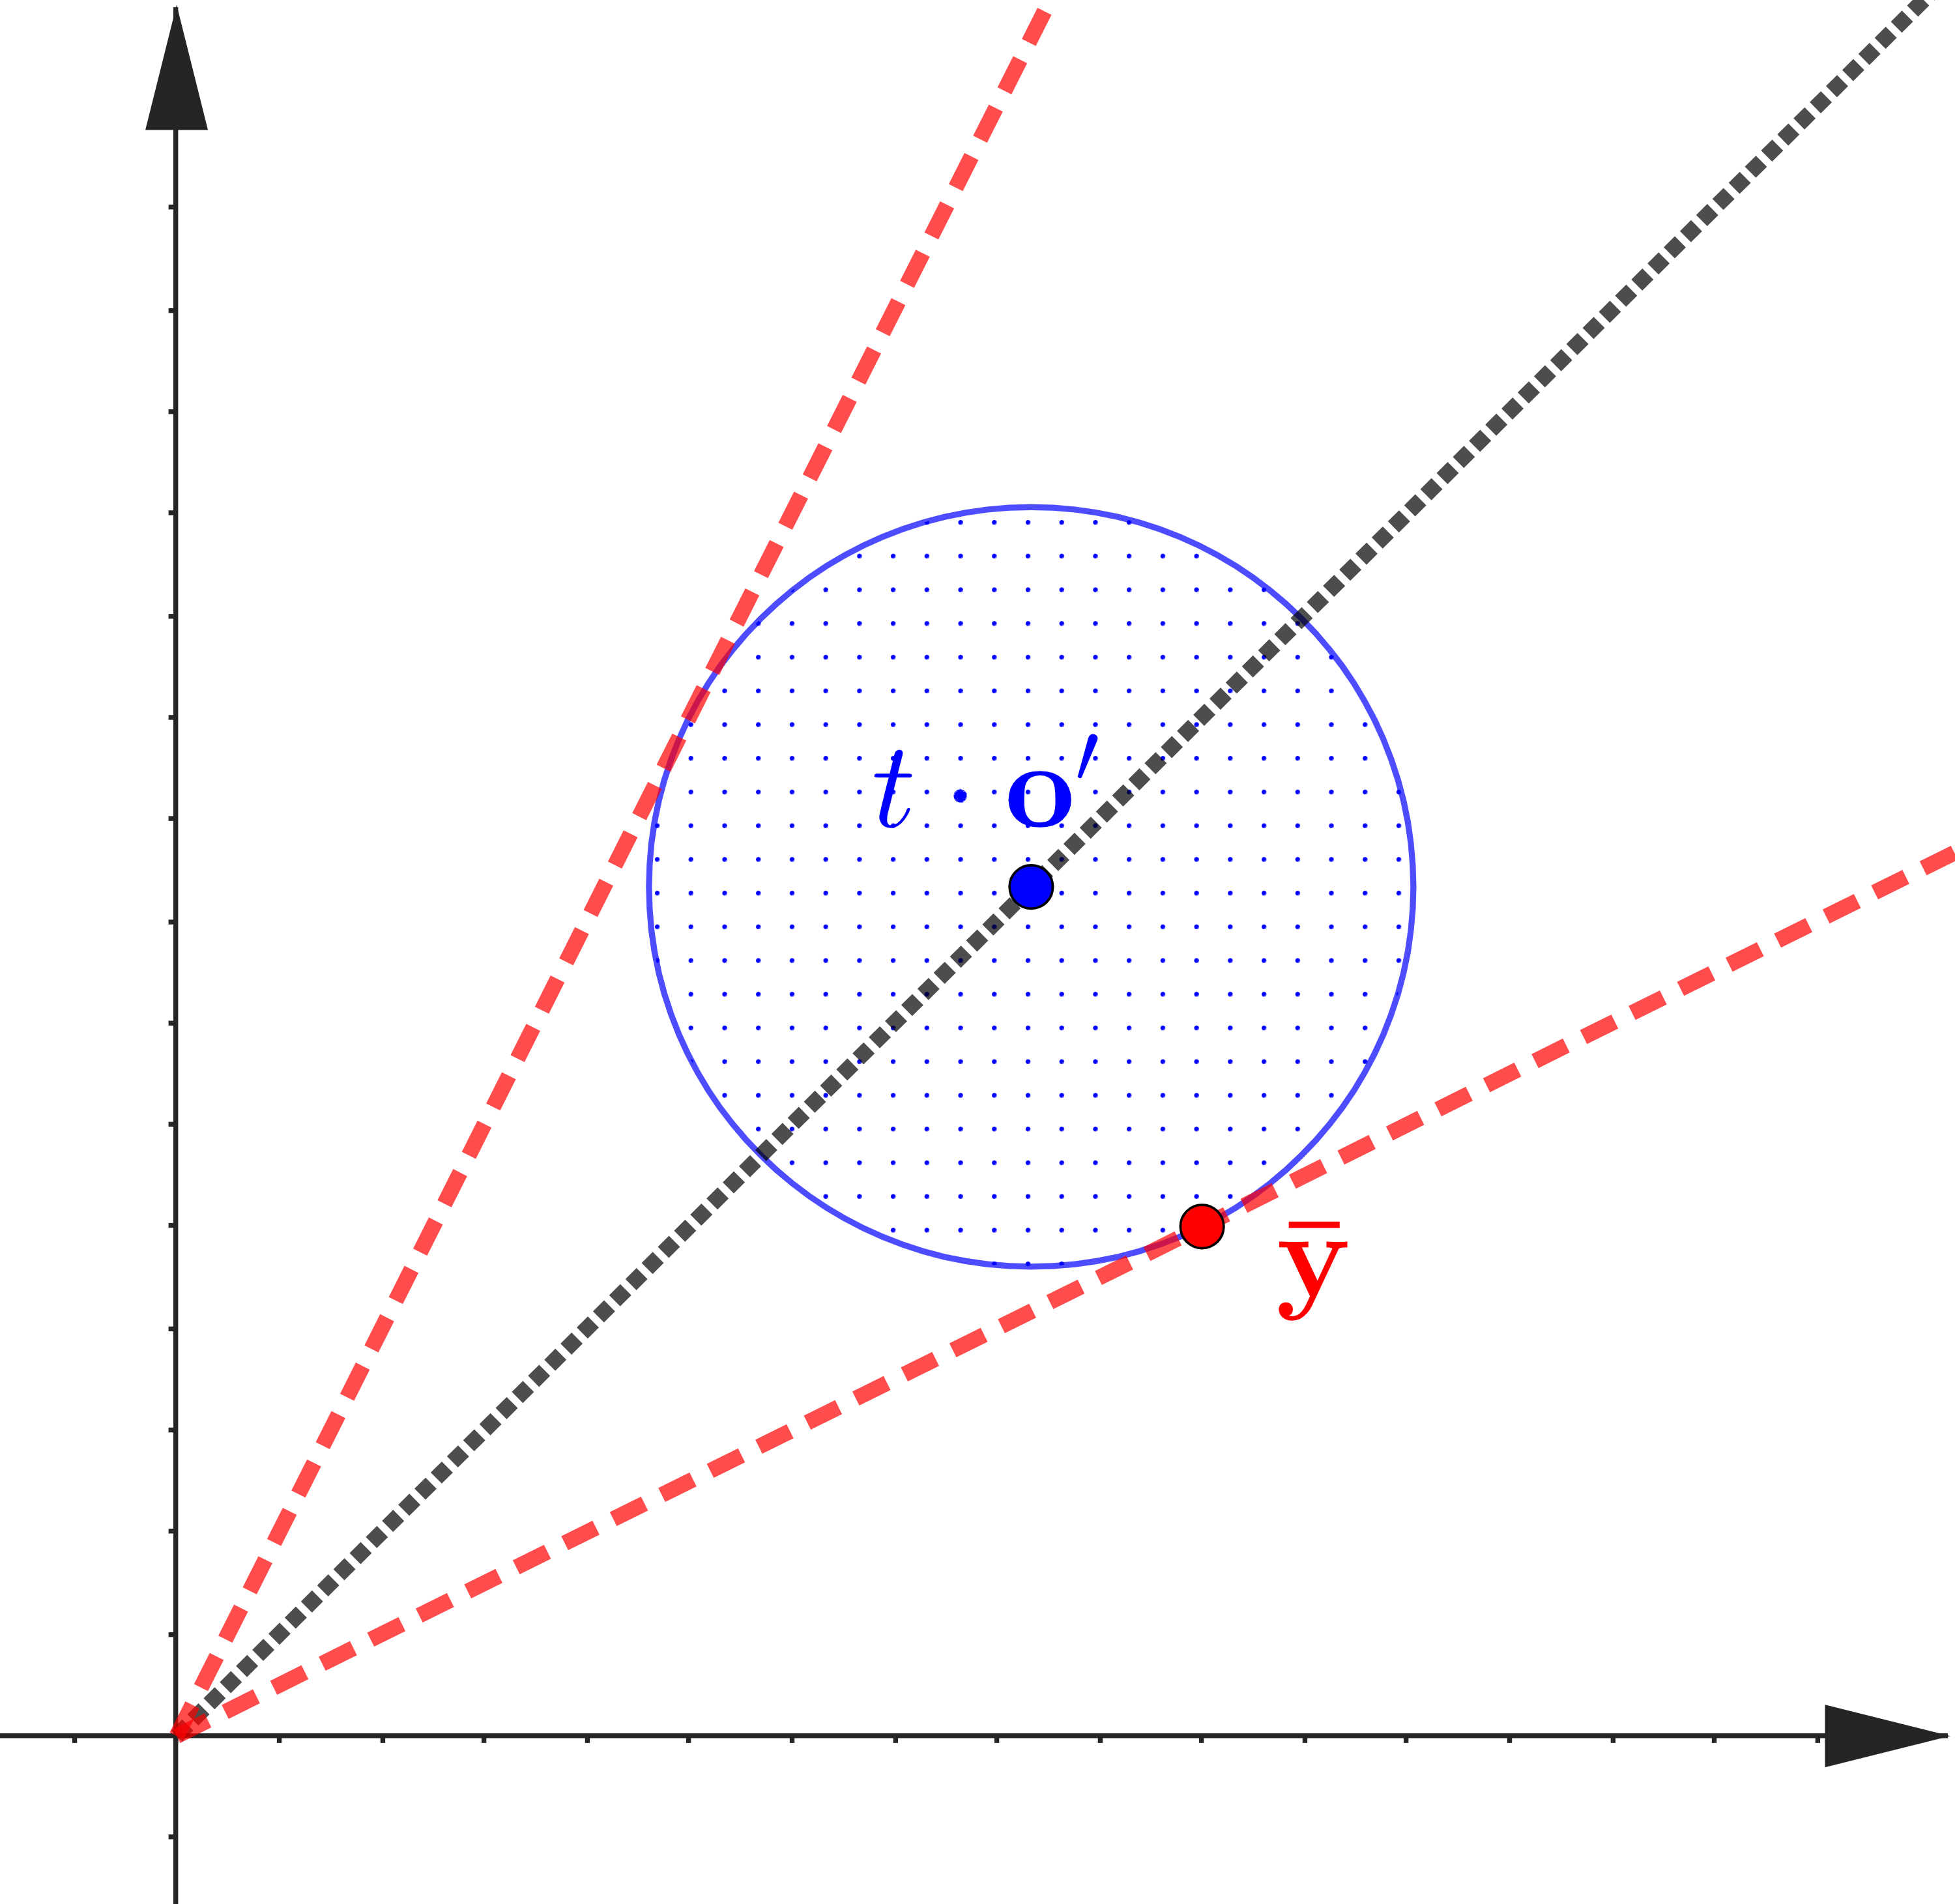
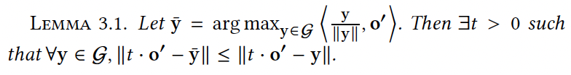
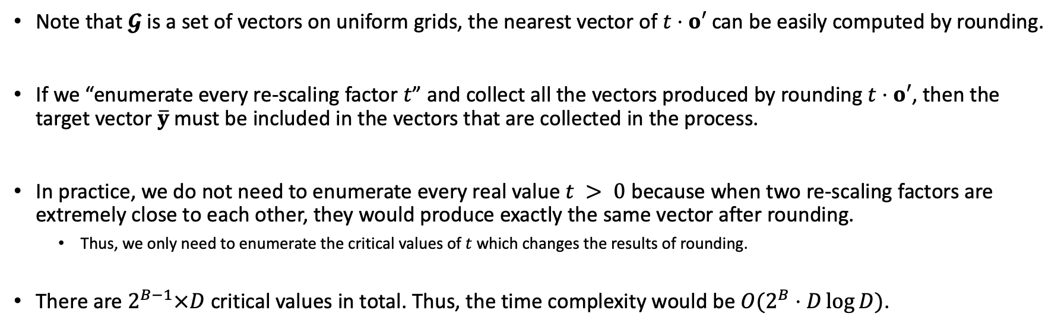
Pruning the Enumeration
Note that $𝓖$ is a set of vectors on uniform grids, the nearest vector of $t⋅o′$ can be easily computed by rounding.
If we “enumerate every re-scaling factor $t$” and collect all the vectors produced by rounding $t⋅o′$, then the target vector $\overline{y}$ must be included in the vectors that are collected in the process.
In practice, we do not need to enumerate every real value $t > 0$ because when two re-scaling factors are extremely close to each other, they would produce exactly the same vector after rounding.
Thus, we only need to enumerate the critical values of $t$ which changes the results of rounding.
There are $2^{B−1}×D$ critical values in total. Thus, the time complexity would be $O(2^{B}⋅D\log{D})$.

Slide 39
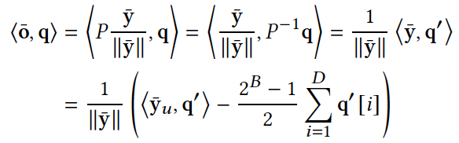
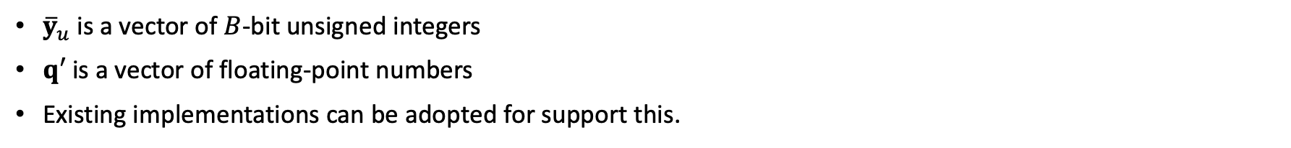
Computing the Estimator
${\overline{y}}_{u}$ is a vector of $B$-bit unsigned integers
$q′$ is a vector of floating-point numbers
Existing implementations can be adopted for support this.

Slide 40
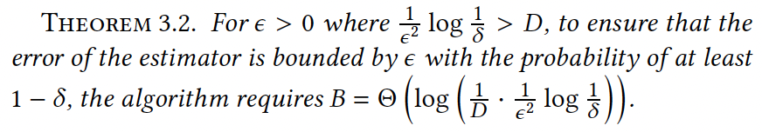
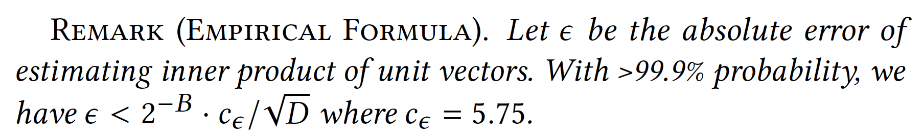
Analysis of Space-Accuracy Trade-off
The theoretical guarantee is asymptotically optimal. To our knowledge, our method is also the first practical algorithm which achieves the optimality.

Slide 41
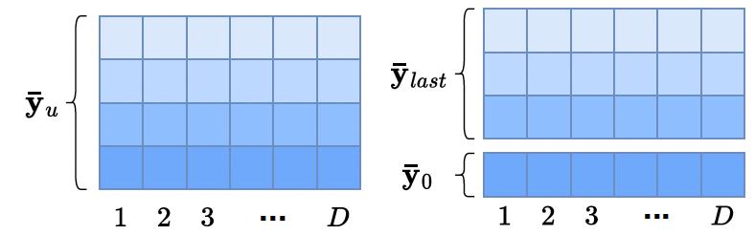
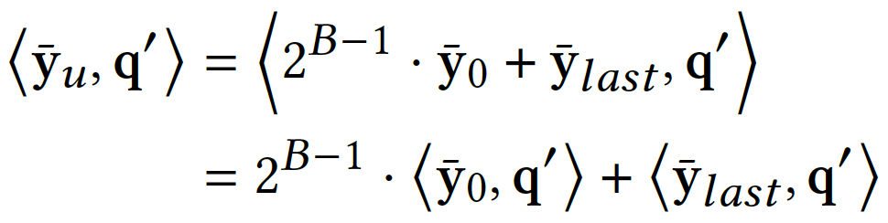
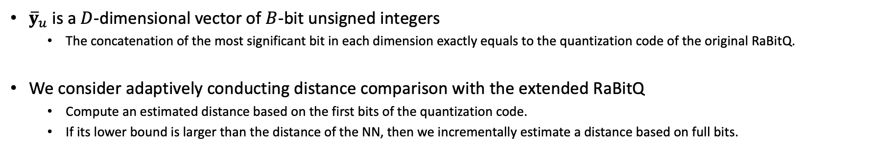
Distance Comparison with Extended RaBitQ
${\overline{y}}_{u}$ is a $D$-dimensional vector of $B$-bit unsigned integers
The concatenation of the most significant bit in each dimension exactly equals to the quantization code of the original RaBitQ.
We consider adaptively conducting distance comparison with the extended RaBitQ
Compute an estimated distance based on the first bits of the quantization code.
If its lower bound is larger than the distance of the NN, then we incrementally estimate a distance based on full bits.

Slide 42
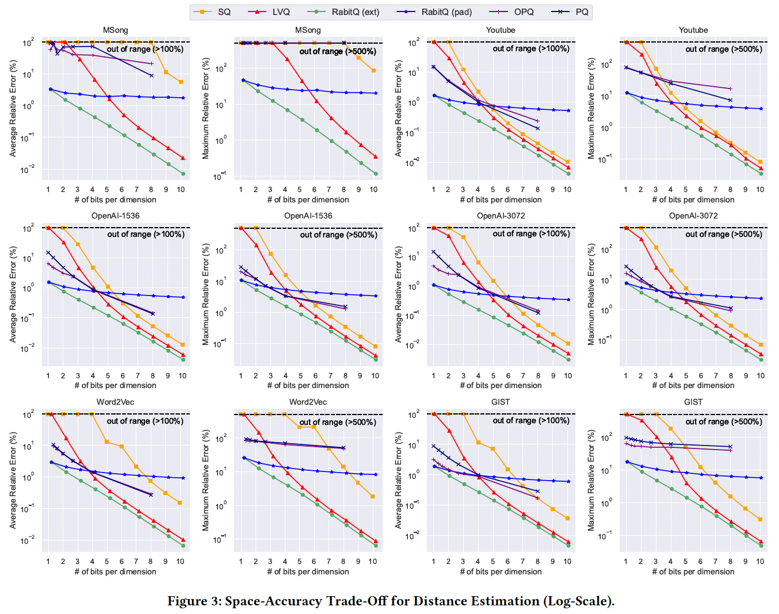
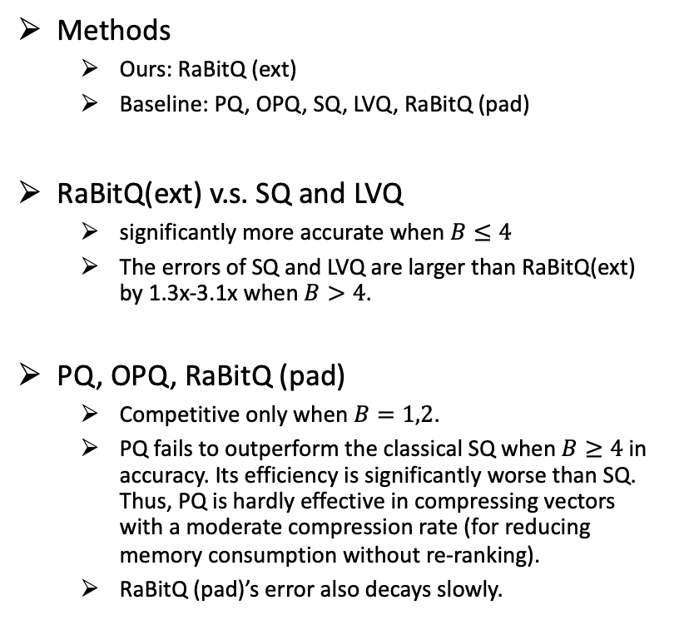
Space-Accuracy Trade-Off for Distance Estimation
Methods
Ours: RaBitQ (ext)
Baseline: PQ, OPQ, SQ, LVQ, RaBitQ (pad)
RaBitQ(ext) v.s. SQ and LVQ
significantly more accurate when $B≤4$
The errors of SQ and LVQ are larger than RaBitQ(ext) by 1.3x-3.1x when $B>4$.
PQ, OPQ, RaBitQ (pad)
Competitive only when $B=1,2$.
PQ fails to outperform the classical SQ when $B≥4$ in accuracy. Its efficiency is significantly worse than SQ. Thus, PQ is hardly effective in compressing vectors with a moderate compression rate (for reducing memory consumption without re-ranking).
RaBitQ (pad)’s error also decays slowly.

Slide 43
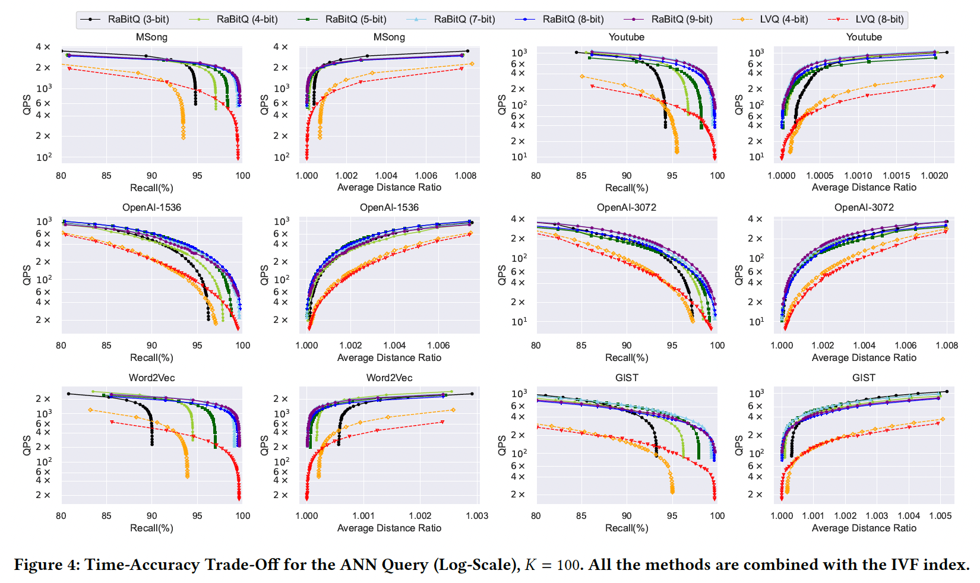
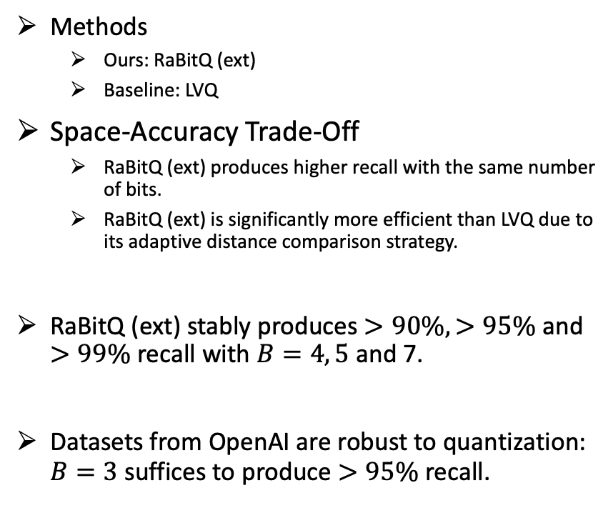
Space-Accuracy Trade-Off for ANN
Methods
Ours: RaBitQ (ext)
Baseline: LVQ
Space-Accuracy Trade-Off
RaBitQ (ext) produces higher recall with the same number of bits.
RaBitQ (ext) is significantly more efficient than LVQ due to its adaptive distance comparison strategy.
RaBitQ (ext) stably produces $>90\%, >95\%$ and $>99\%$ recall with $B=4, 5$ and 7.
Datasets from OpenAI are robust to quantization: $B=3$ suffices to produce $>95\%$ recall.

Slide 44
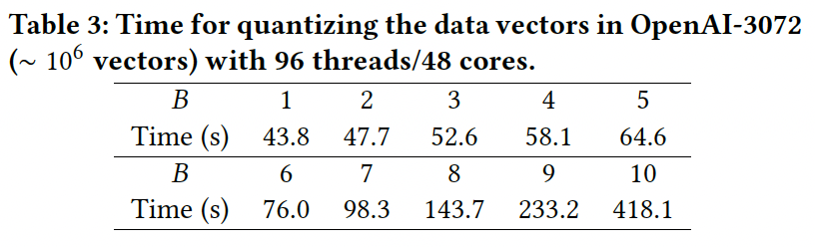
Quantization Time during Indexing

Slide 45
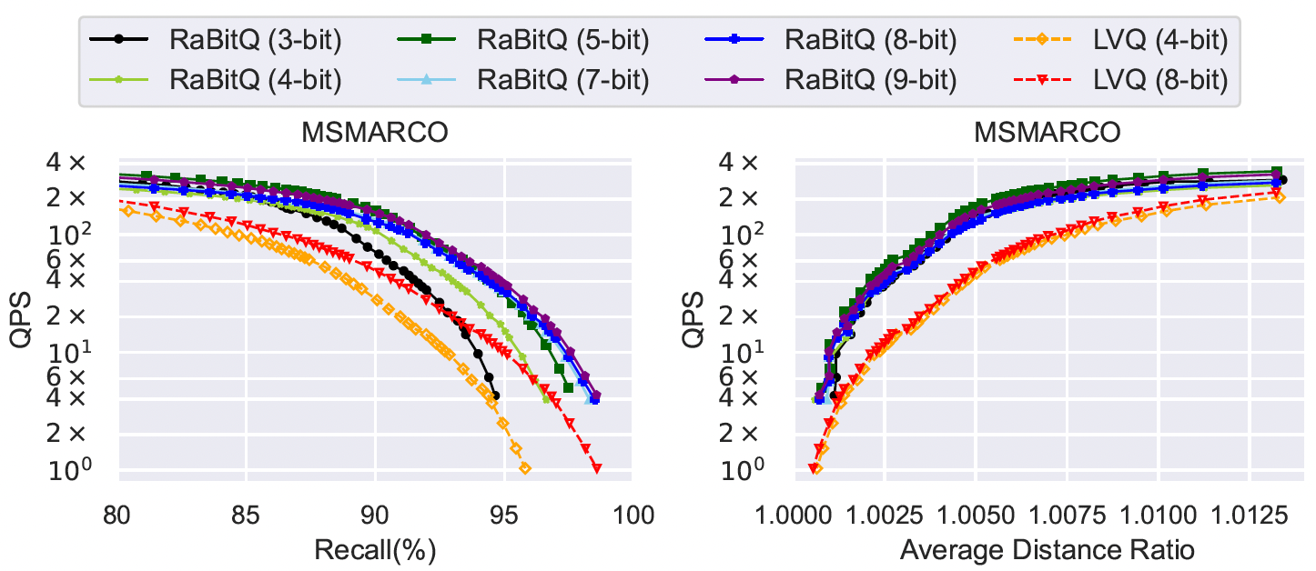
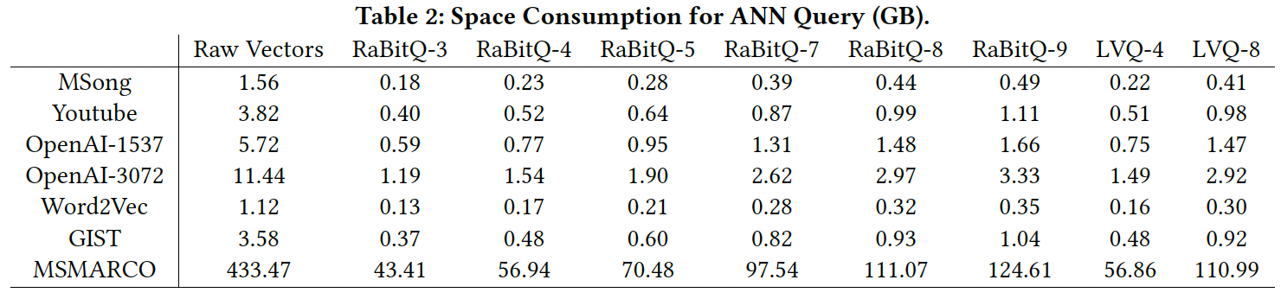
Scalability
MSMARCO has ~100M 1,024-dimensional vectors.
Every bit matters when the dataset is large, and the dimensionality is high.

Slide 46
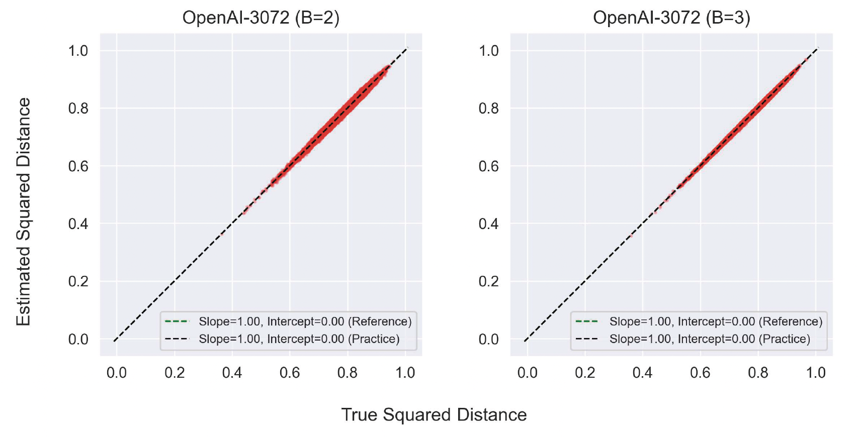
Unbiasedness

Slide 47
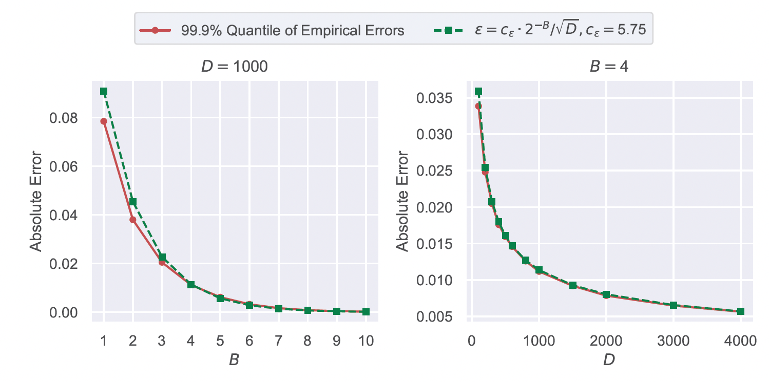
Empirical Formula

Slide 48
Summary & Discussion
Methods: a quantization algorithm which extends RaBitQ
It supports efficient implementations of inner product and Euclidean distances.
It has superior accuracy at a wide range of compression rates (3x-32x).
It achieves the asymptotical optimal in terms of the space-accuracy trade-off for estimating inner product of unit vectors.
Possibly Applications & Research Directions
Various application scenarios in vector search (e.g., disk, cloud).
In its nature, it reduces the number of accessed bits needed for answering a query.
Machine learning systems.

Slide 49
Q & A
Thanks for your attention!
jianyang.gao@ntu.edu.sg

